Slide 1


Ministry of Communications and Information Technology
Information Technology Institute
Information Technology Institute
Haitham A. El-Ghareeb, Ph.D.
Associate Professor
Information Systems Department
Faculty of Computers and Information Sciences
Mansoura University
http://www.helghareeb.me
2012

Slide 2

2000 – 2002 - 2004

Slide 3
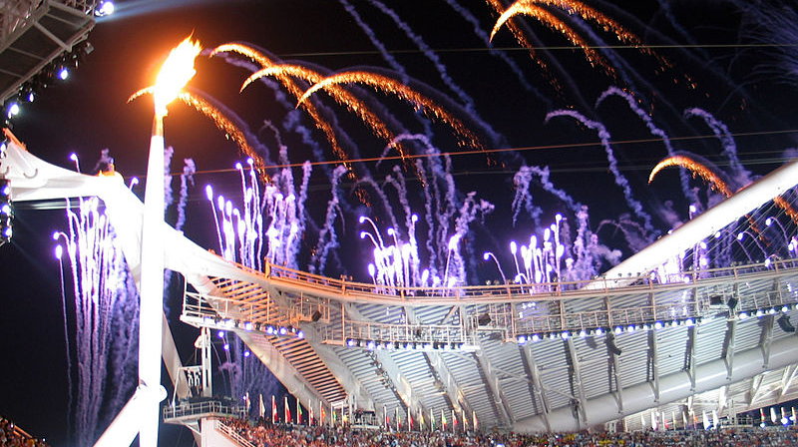
Graduation - 2004

Slide 4

MCSD

Slide 5

SQL Server - 2000

Slide 6
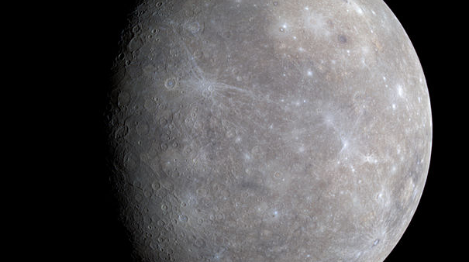
Masters - 2008

Slide 7
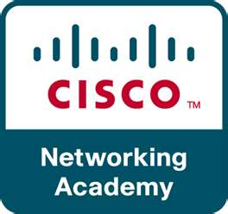

Slide 8

Fundamentals

Slide 9

Routing

Slide 10
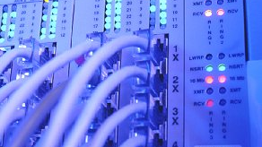
Switching

Slide 11
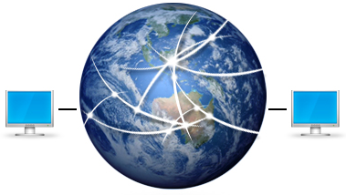
WAN

Slide 12

Ph.D. - 2011

Slide 13


Slide 14
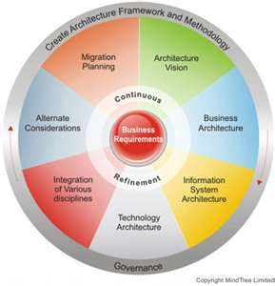
Service Oriented Architecture

Slide 15

Web Services

Slide 16

Integration

Slide 17


Slide 18


Slide 19

Optimization

Slide 20


Slide 21


Slide 22


Slide 23


Slide 24


Slide 25


Slide 26


Slide 27

Academia

Slide 28
Ministry of Communications and Information Technology
Information Technology Institute
Information Technology Institute
Network Fundamentals
Lecture 1

Slide 29
Course Description
Cover Principles and Practice of Computer Networking (Emphasis on Internet Services)
Explain the Structure and Components of Computer Networks (LAN, WAN, Internet Applications)

Slide 30
Course Outline
Network Fundamentals
OSI Model
Network Protocol and Devices
TCP / IP

Slide 31
Network Fundamentals
Basic Network elements
Classifications of Networks
Network Tranmission Media

Slide 32
OSI Model
Introduction to OSI Model
Application Layer
Presentation Layer
Session Layer
Transport Layer
Network Layer
Data Link Layer
Physical Layer

Slide 33
Network Protocols and Devices
Network Communicating Protocols
Protocols in OSI Model
Devices used in Networking

Slide 34
TCP/IP
Collision Domain and Broadcast Domain
Types of Broadcast Addresses
Fragmentation
Subnetting

Slide 35
Chapter one
Network Fundamentals

Slide 36
Objectives
By the end of this chapter, you will be able to:
  Define the meaning of Network and its benefits
  Classify the basic Network Elements and its roles
  Differentiate between different types of Networks
  Define the Transmission media of the Network

Slide 37
Topics
Lesson 1: The Network and its Benefits
Lesson 2: Basic Network Elements
Lesson 3: Network Transmission Media
Lesson 4: Classification of Networks

Slide 38
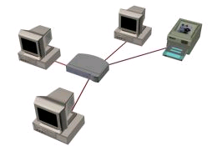
What is the Computer Network?
Computer Network means, a collection of Computers, and other devices, or peripherals connected together through connecting media

Slide 39
Peripheral Device
A computer device, such as CD-ROM drive or printer, that is not part of the essential computer, i.e., the memory and microprocessor.
Peripheral devices can be external – such as mouse, keyboard, printer, monitor, external Zip drive or scanner.
Peripheral devices can be internal, such as CD-ROM drive, or internal modem.
Internal peripheral devices are often refered to as integrated peripherals.
Source: http://www.webopedia.com/TERM/P/peripheral_device.html

Slide 40
Benefits of Computer Networks
Resources Sharing
  File Sharing
  Peripheral Sharing
  Software Sharing with multi-user licenses

Slide 41
Basic Network Elements
Hardware
  Computers / Peripherals
  NICs
  Connecting Media
  Networking Device(s)
    Routers
    Switches
    Bridges
    Hubs
Software
  Protocols
    Communication rules that all entity must agree on

Slide 42
Network Devices
NIC (Network Interface Card)
  The hardware that plugs into the motherboard and directly access the network
Hub
  Allow different nodes to communicate with each other
Switch
  Allow different nodes to communicate with each other
  at the same time without slowing each other down.
Router
  Allow different networks to communicate with each other

Slide 43

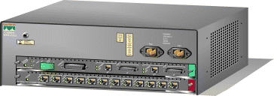
Hub
Switch

Slide 44
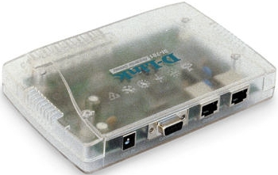
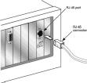

Router
NIC

Slide 45
Classifications of Networks
According to Covered Area
According to Network Model
According to Network Topology

Slide 46
Area Networks
Local Area Networks
  A LAN is a group of computers connected in small geographical area
  Allow users to share files and services
Wide Area Networks
  A WAN is a group of computers connected in Large geographical area such as country
  A WAN often connects two LANs (WAN Link)
Metropolitan Area Networks
  A MAN connects an area larger than a LAN but smaller than a WAN, such as a city.

Slide 47
Network Models
Two basic types of networks
  Peer-to-Peer Networks
  Client/Server Networks

Slide 48
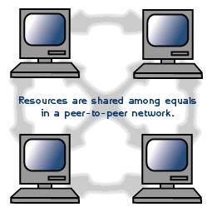
Peer-to-Peer Networks
In a peer-to-peer network, all computers are considered equal; they all have the same abilities to use the resources available on the network.
Example : Windows Workgroup
Notes:
In a peer-to-peer network, various computers on the network can act both as clients and servers. For instance, many Microsoft Windows based computers will allow file and print sharing. These computers can act both as a client and a server and are also referred to as peers.

Slide 49
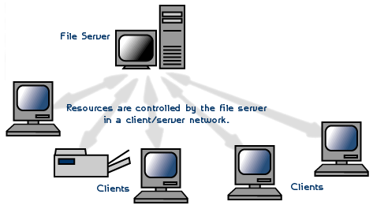
Client/Server Networks
Some nodes (SERVER) are dedicated to present services to other nodes (CLIENTS)
Examples:
  Mail Server
  Web Server
Notes:
In a server based network, there are computers set up to be primary providers of services such as file service or mail service. The computers providing the service are called servers and the computers that request and use the service are called client computers.

Slide 50
Client Server Model
Initiates a request
Client
Server
Replies with a service
Client
Client
Notes:
Servers are those computers who reply with services to clients. Clients are those computers who request services from servers.
First, client initiates a request sent to a certain server, then the server replies with the service required to the client.
As we see above, there are many clients and one server, (actually, the number of servers is very small compared with the number of clients)

Slide 51
Network Topologies
Topology refers to the shape of a network, or the network's layout.
How different nodes in a network are connected to each other and how they communicate are determined by the network's topology.
The choice of topology is dependent upon
  Type and number of equipment being used
  Cost
Notes:
Topology: how, and in what shape, network components are connected together
Each topology is suited to specific tasks and has its own advantages and disadvantages.

Slide 52
Network Topologies
Computer networks topologies
  Bus
  Star
  Ring
  Mesh
  Hybrid

Slide 53
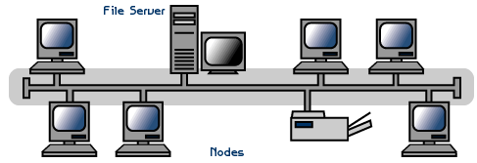
Bus Topology
All devices are connected to a central cable, called the bus or backbone.

Slide 54
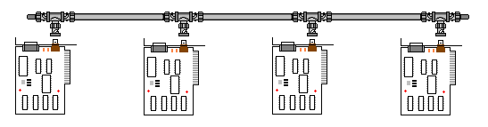
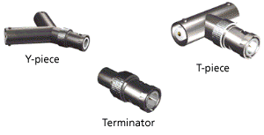
Bus Topology
Both ends of the network must be terminated with a terminator.
A barrel connector can be used to extend the network.

Slide 55
Bus Topology
The backbone functions as a shared communication medium
Device wanting to communicate with another device on the network sends a message onto the backbone
The message is heard by all stations, but only the intended recipient actually accepts and processes the message.
Terminator absorbs frames at end of medium

Slide 56
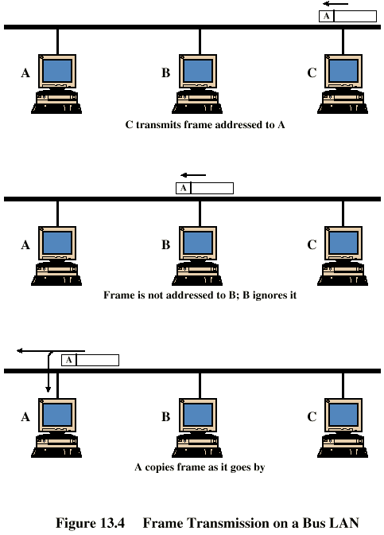
Frame Transmission - Bus LAN
Example:
Station C want to transmit a frame of data to station A.

Slide 57
Bus Advantages and Disadvantages
Advantages
  Simple, easy to use and construct
  Requires least amount of cable (less expensive)
Disadvantages
  A faulty cable will take the entire LAN down
  Difficult to troubleshoot
  Heavy network traffic can slow bus considerably
Notes:
When a problem occurs, it is not so easy to get the solution of it, the cause of it may be due to many reasons
When the number of PCs increases, the collision rate increases which will be translated in a bad performance

Slide 58
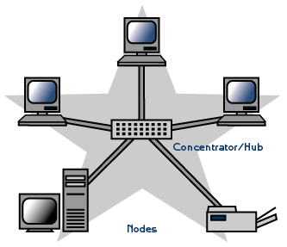
Star Topology
A physical Star topology connects the devices via a centralized unit such as a Hub or Switch.
Nodes communicate across the network by passing data through the central device.

Slide 59
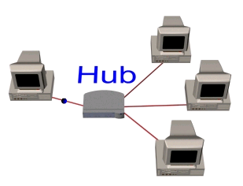
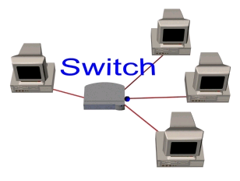
Star Types
Broadcasted Star Topology (Hubbed Star)
Switched Star Topology (Switched Star)
Notes:
Broadcasted Star Topology
-Through a hub which sends message out of all ports
- Physical star, logically bus
- Only one station can transmit at a time
Switched Star Topology
- Through a switch which sends messages to only destination computer

Slide 60
Star Advantages
Single computer failure doesn’t bring down whole network
Adding new devices to a Star network is very simple compared to any of the other topologies
No disruptions to the network when connecting or removing devices.
Centralized control
Centralized network/hub monitoring
Easy to troubleshoot

Slide 61
Star Disadvantages
If central device fails, the whole network fails
Compared to the bus topology, a star network generally requires more cable
More expensive than linear bus topologies because of the cost of the central device

Slide 62
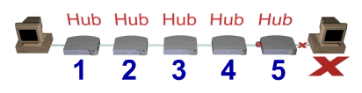
Hubbed Star Rule
Hubs simply pass on all the information they receive.
This limits the number of hubs you can connect together.
The maximum number of allowed repeater hops is four.

Slide 63
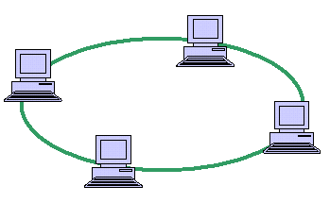
Ring Topology
All devices are connected to one another in the shape of a closed loop, so that each device is connected directly to two other devices, one on either side of it.
Data is passed one way from device to device.

Slide 64
Ring Topology
A short message (called a token) is circulated around the ring, being passed from station to station.
The token originates from a controller or master station which inserts it onto the ring.
A station which wants to transmit waits for the token to arrive.
When the token arrives, the station changes it from a token to a connector message, and appends its message. This new message is then placed on the outgoing side of the ring.

Slide 65
Ring Topology
Each station passes on received tokens if they have nothing to transmit.
They monitor connector messages to see if the message is addressed to them.
If connector messages are addressed to them, they copy the message, modify it to signify its receipt, then send it on around the ring.
Connector messages which are not addressed to them are passed directly on to the next station in the ring.
When the connector message travels full circle and arrives at the original sending station, it checks the message to see if it's been received. It then discards the message and replaces it with a token.

Slide 66
Ring Advantages and Disadvantages
Advantages
  Perform well under heavy traffic
Disadvantages
  If one device/cable fails then the whole network goes down.
  Difficult to troubleshoot
  Adding/Removing computers disrupts the whole network

Slide 67
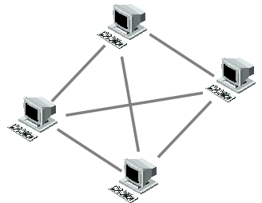
Mesh Topology
In a mesh topology each device/PC is connected to every other device/PC in the network by its own cable
Notes:
The amount of cables you will need for a mesh network can be calculated by: CN = (D * (D-1)) / 2
(where CN is Cables Needed, and D is the amount of devices on the network)
If your network was going to have 4 clients/devices then you would need 4 * 3 / 2 = 6 cables
The problems come with a large network, imagine a 40 device network: 40 * 39 / 2 = 780 cables

Slide 68
Mesh Types
Full Mesh
Partial Mesh

Slide 69
Mesh Advantages and Disadvantages
Advantages
  Mesh topology boasts the highest fault tolerance of all of the network topologies
Disadvantages
  Because each connection needs its own cable a Mesh topology can get very expensive.

Slide 70
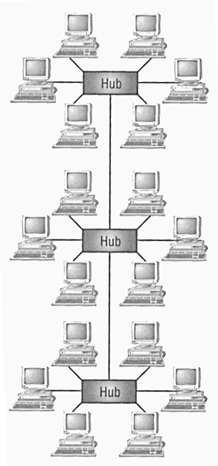
Hybrid Topologies
Hybrid means that there is more than one topology exist
Stared Bus
  Groups of star-configured networks are connected to a linear bus backbone

Slide 71
Hybrid Advantage and Disadvantage
Advantages:
  Network expansion is simple
Disadvantages:
  If hub fails connections between failed hub and other hubs will fail

Slide 72
Network Transmission Media

Slide 73
Network Transmission Media
To transmit data, a medium must exist
The medium can be in the form of cables or wireless medium
Most common used media for data networks
  Twisted pair cable
  Coaxial cable
  Fiber optic cable
  Wireless media

Slide 74
Network Transmission Media
Cable Media
  Twisted Pair Cables
    STP
    UTP
  Fiber Optic Cables
  Coaxial Cables
Wireless Media
  Infra red
  Microwave
  Bluetooth

Slide 75
Network Transmission Media
Cable Media
  There are several types of cable which are commonly used with LANs.
  In some cases, a network will utilize only one type of cable, other networks will use a variety of cable types.
  The type of cable chosen for a network is related to the network's topology, protocol, and size.

Slide 76

Twisted pair cable
Most widely used (Ethernet networks)
The segment can’t exceed 100 meters
Two basic types
    STP
    UTP
Use RJ-45 connectors
Crimper tool attach the twisted pair cable to RJ-45

Slide 77
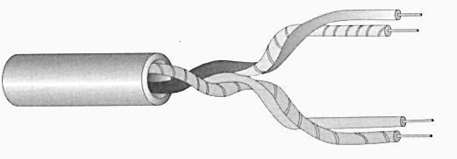
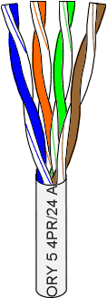
Unshielded Twisted Pair (UTP)
Low Cost
Easy Installation
Bandwidth ~ 1,4,10,16,100,1000 Mbps
Attenuation ~ hundred of meters (high)
Notes:
Bandwidth (data transfer rate) the amount of data that can be carried from one point to another in a given time period, usually a second
Attenuation, is a loss of signal strength measured in decibles. Occurs for different reasons:
range, both wireless and wired transmissions gradually dissipate in strength over longer reaches
Interference, on wireless networks, radio interference or physical obstructions like walls dampen communication signals
Wire size – on wired networks, thinner wires suffer from hiegher (more) attenuation than thicker wires
Attenuation is the opposite of amplification

Slide 78
UTP Categories
The UTP cables are classified into many types called categories:
  Cat 1 : which supports up to 1 Mbps
  Cat 2 : which supports up to 4 Mbps
  Cat 3 : which supports up to 10 Mbps
  Cat 4 : which supports up to 16 Mbps
  Cat 5 : which supports up to 100 Mbps ( this is the kind used in Ethernet networks )
The principle upon which the UTP cables are classified is the amount of twisting, when the twisting amount is increased, the interference amount is decreased, . as a final result, the bandwidth the cable support increases

Slide 79
UTP Categories
(a) Category 3 UTP.
(b) Category 5 UTP.

Slide 80
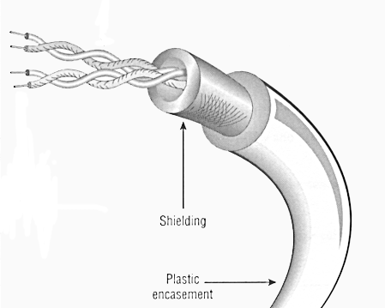
Shielded Twisted Pair (STP)
Moderate Cost
Fairly Easy Installation
Bandwidth ~ more than same cat of UTP
Attenuation ~ hundred of meters
Notes:
The STP is similar to UTP, but it has an outer layer to protect the cable from the surrounding noise, so it carries more bandwidth

Slide 81
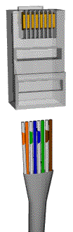
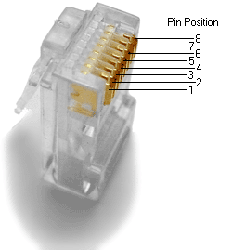
Connector Used
123 ……… 8
RJ-45

Slide 82
Twisted Pair Cable Connection Types
Dropped Cable (Patch Chord / Straight)
Cross-over Cable
Rolled-over Cable

Slide 83
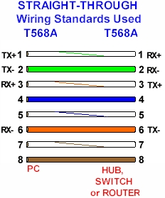
Dropped (Patch Chord / Straight) Cable
1
2
3
6
1
2
3
6
Notes:
This kind of cables is used to connect PCs to hubs or switches.

Slide 84
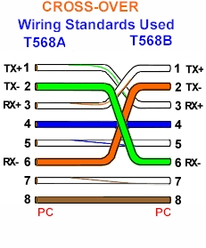
Cross-over Cable
1
2
3
6
3
6
1
2
Notes:
This kind of cables is used when connecting two similar devices, PC to PC, Hub to Hub, ….etc.

Slide 85
Rolled-over Cable
1
2
3
4
5
6
7
8
8
7
6
5
4
3
2
1
Notes:
This kind of cables is used to configure devices used in networking, such as switches and inter-networking, such as routers, …etc.

Slide 86
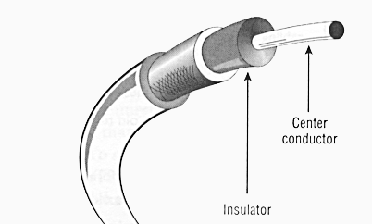
Coaxial
Cost is Moderate
Fairly Easy Installation
Bandwidth ~ 10 Mbps
Attenuation ~ few hundreds of meters

Slide 87
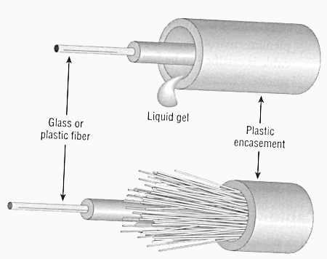
Fiber-optic
Highest Cost
Difficult Installation
Bandwidth ~ 2 Gbps
Attenuation ~ ten of kilometers (low)

Slide 88
Wireless Media
Flexible (Used in areas where it is hard to install cables )
Used in wireless LANs
Hybrid environment is one which wireless components communicate with a network that use cables

Slide 89
summart

Slide 90
In this Chapter, we explained:
The meaning of the Network and its benefits
The Basic Network Elements and the difference between them
The Classifications of Networks
Network Transmission Media

Slide 91
quiz
Choose the Correct Answer

Slide 92
…… is the hardware that plugs into the motherboard and directly access the network.
  Hub
  NIC
  Switch
  Router

Slide 93
In …. Nodes communicate across the network by passing data through the central device.
  Bus topology
  Hybrid topology
  Star topology
  A, B, and C

Slide 94
All devices are connected to a central cable, called the bus or backbone in …..
  Bus topology
  Hybrid topology
  Star topology
  A, B, and C

Slide 95
Computer Networks has a lot of benefits for instance….
  File Sharing
  Peripheral Sharing
  Software sharing with multi-user liscenses
  A, B, and C

Slide 96
…… cable can be used in Ethernet networks.
  Twisted pair
  Fiber optic cables
  Coaxial cables
  A, B, and C

Slide 97
Thank you

